Slide 1




Petroleum Product Consumption Analysis
Indian Government Dataset Analysis
Source: https://www.data.gov.in/
Email : harshithasai4073@gmail.com
Contact: 7207012049
LinkedIn: https://www.linkedin.com/in/harshithasaimadala/

Slide 2
Introduction
This presentation provides an analysis of the petroleum product consumption dataset, covering:
Trends in petroleum consumption over time
Yearly and sector-wise distribution
Regional consumption variations
Key insights and conclusions

Slide 3
Initial Analysis of the Dataset
Dataset Overview:
The dataset contains 492 rows and 5 columns.
It records petroleum product consumption data by month and year.
The dataset has no missing values.
The data types include categorical (Month, Products), numerical (Quantity), and datetime-like (Year, Updated Date) values.
Key Analysis:
Month, Year: Identifies the time period of the petroleum consumption data.
PRODUCTS: Lists different types of petroleum products consumed.
Quantity (000 Metric Tonnes): Represents the amount of petroleum consumed in metric tonnes.
updated_date: Shows when the data was last updated.

Slide 4
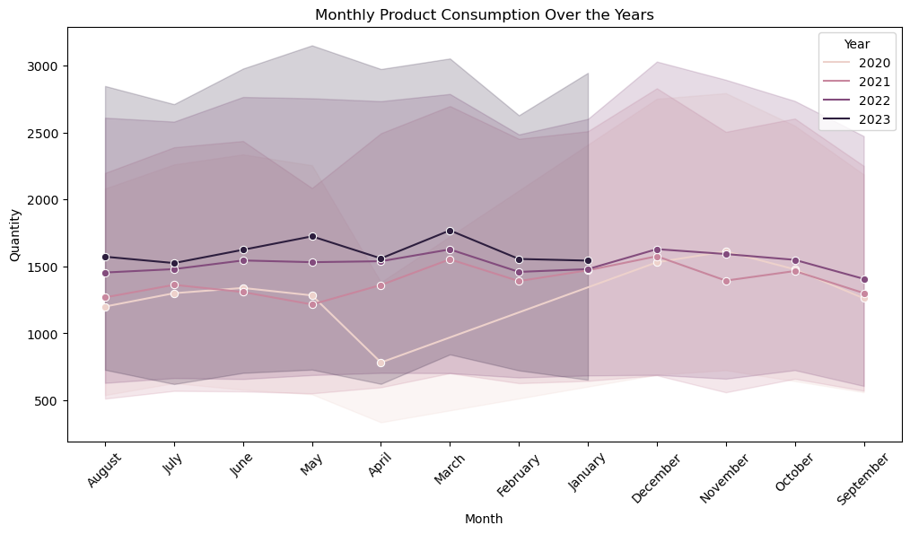
Data Analysis & Visualization
1)Monthly Consumption Trends

Slide 5
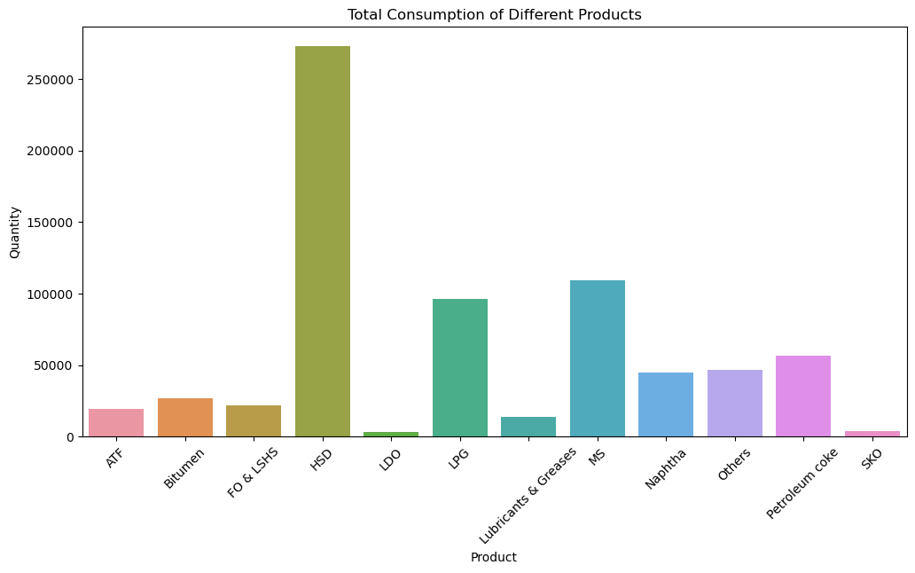
2) Product-Wise Consumption

Slide 6
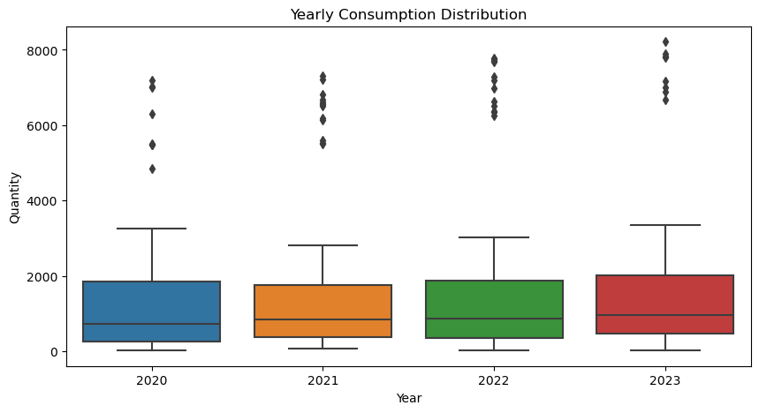
3)Yearly Consumption Trend

Slide 7
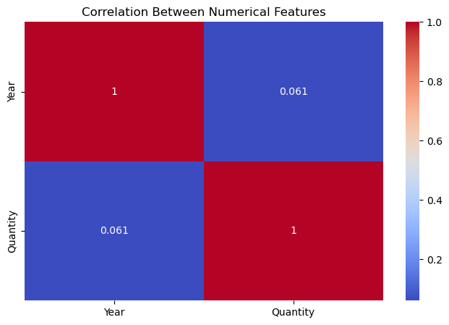
4) Correlation Analysis

Slide 8
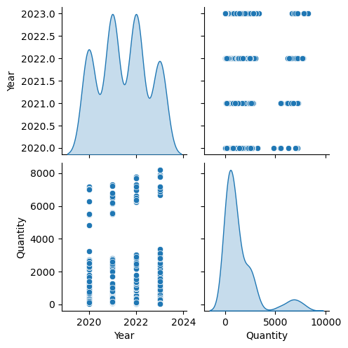
4)Pair Plot of Numerical Features

Slide 9
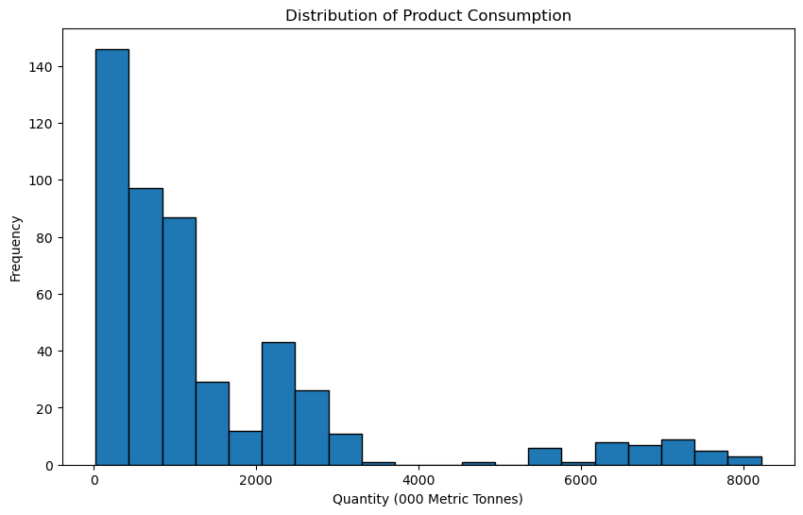
5) Histogram of Product Consumption

Slide 10
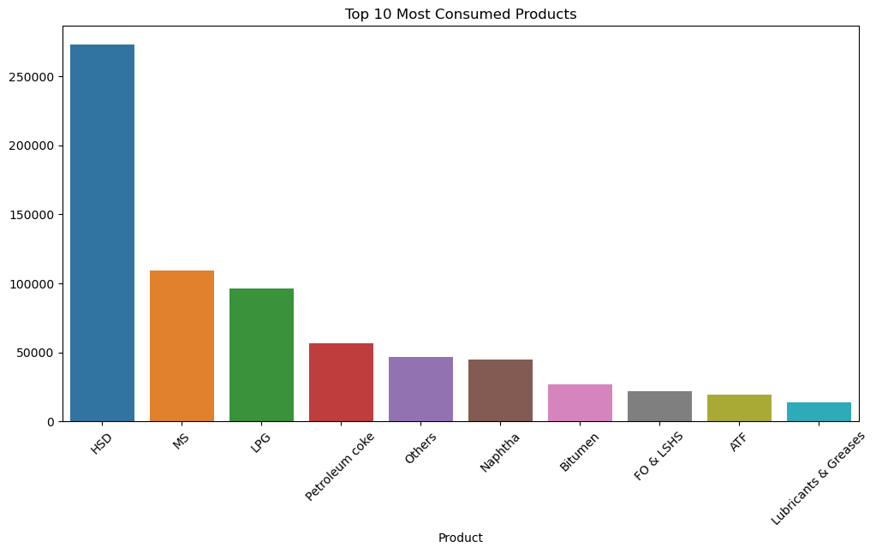
6)Top 10 Consumed Products

Slide 11
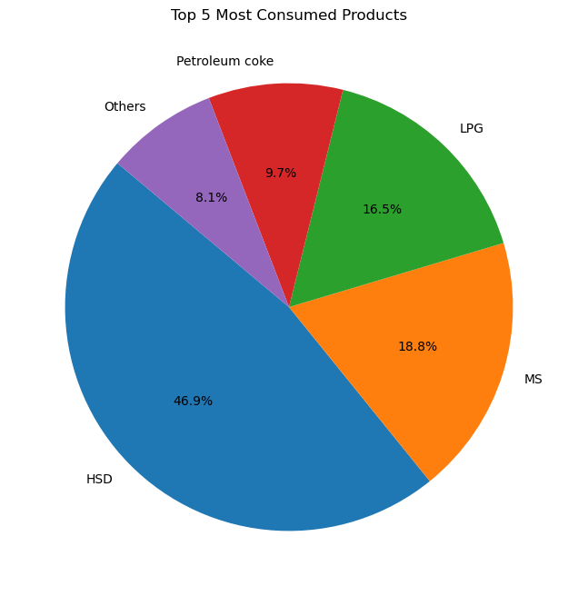
7) Top 5 Consumed Products

Slide 12
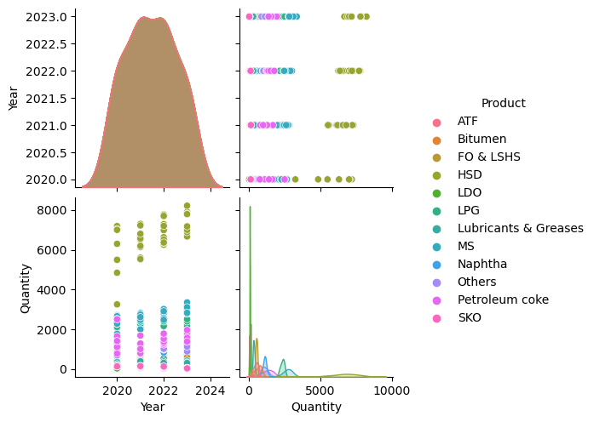
8)Pair Plot Relationship between Numeric Features

Slide 13
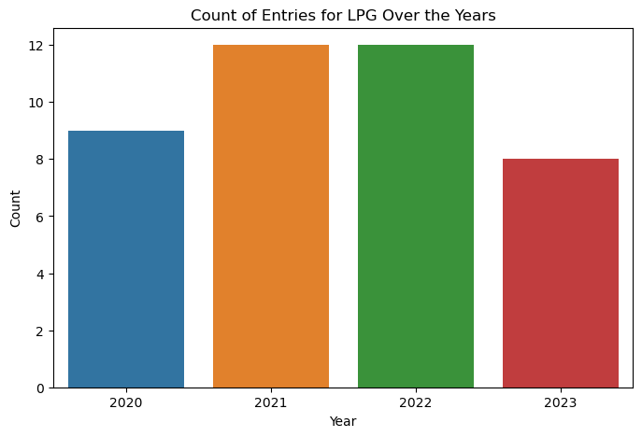
9) Count of Entries for LPG over the Years

Slide 14
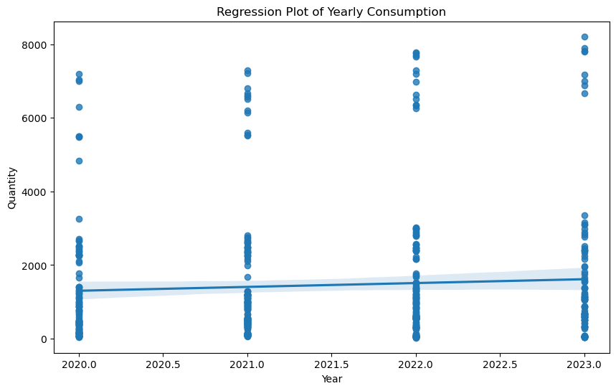
10)Regression Plot of Yearly Consumption

Slide 15
Dataset Observation
The data file, titled `productconsumption.csv`, is read into the notebook with Pandas. A first check is run with `df.info()` to identify data types and missing values, and ‘df.head()’ gives a glimpse of the first rows. This ensures proper understanding of the dataset structure prior to any more advanced analysis.
For cleaning and preprocessing of data, the ‘Updated_Date’ column is changed to datetime format to enable time-based analysis. The dataset contains five important columns: `Month`, `Year`, `Product`, `Quantity`, and ‘Updated_Date’. These attributes assist in analyzing monthly product consumption patterns across various years. While missing or inconsistent values are not specifically addressed in the code that can be seen, additional steps may be necessary to clean the dataset and maintain data integrity.
The dataset seems to be centered on the patterns of fuel consumption, including products like Petrol, Diesel, LPG, and ATF. This would indicate that time-series analysis would be feasible to determine the patterns and seasonality in demand. It would also be interesting to analyze the patterns of consumption over various months and years to give insights into the usage trends as well as any correlations to outside factors. More exploratory data analysis might need to be done to extract significant conclusions from the dataset.

Slide 16
Conclusion
The analysis of petroleum product consumption reveals significant trends over time, highlighting seasonal variations and demand patterns. Converting date formats enabled time-series analysis, while further exploration can provide insights into external factors affecting fuel consumption. This study helps in understanding market dynamics for better decision-making in the energy sector.

